Slide 1
Movielen Dataset Recommend System
Members:
Phan Duc Hung Nguyen Nam Hai Le Ngoc Binh Nguyen Thanh Binh Tran Quoc De | 20214903 20214894 20214878 20210106 20210179

Slide 2
Table Of Content
Introduction
Dataset
Methods
Experiment Result
Contributions

Slide 3
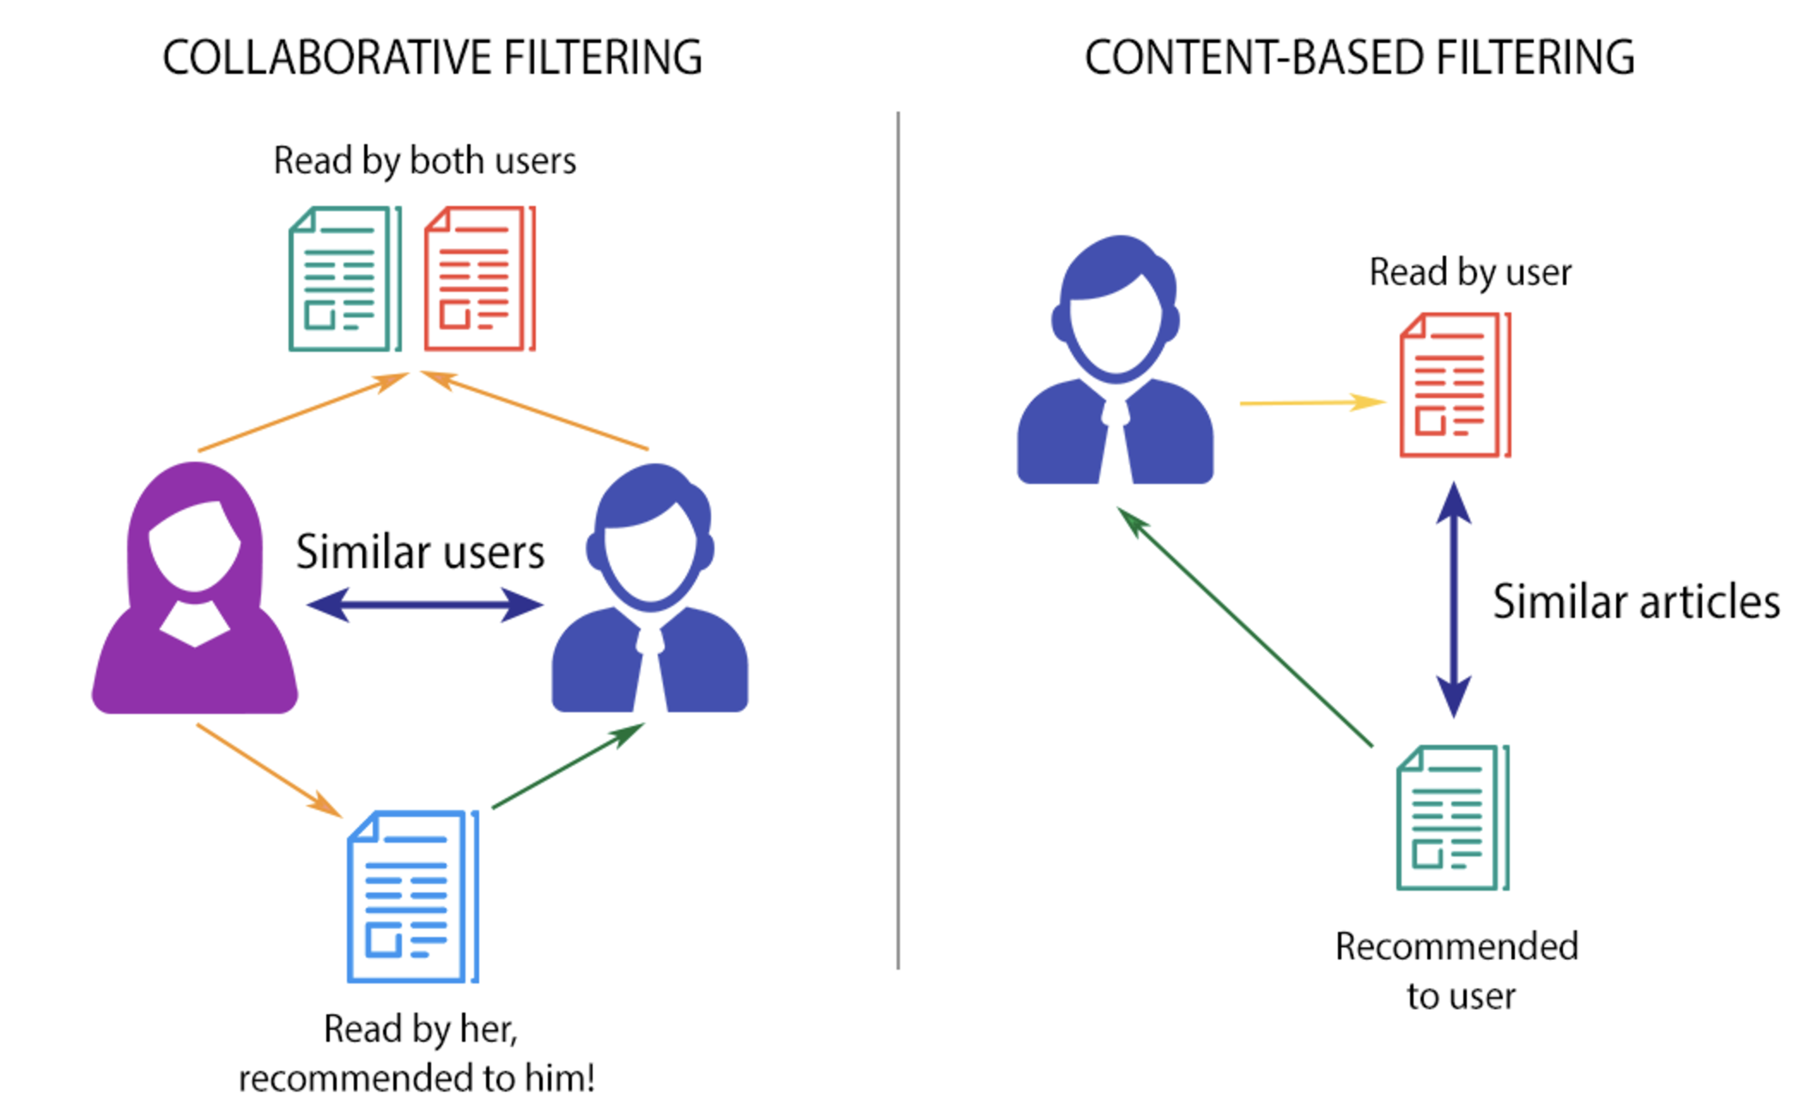
1. Introduction
What: Systems that suggest things you might like (e.g., movies, products).
Why:
Help users find what they need.
Boost sales and user activity for retailer.
Types:
Content-Based Filtering: Matches item features with user preferences.
Collaborative Filtering: Leverages preferences of similar users.
Target:
Unify the methods on the same dataset for comparison.
Explore cold-start problem

Slide 4
2. Dataset
Overview:
Contains 100,000 ratings (1-5) from 943 users on 1,682 movies.
Users have rated at least 20 movies.
Collected from September 1997 to April 1998 via MovieLens website.
Data Descriptions:
u.data: Ratings data (user ID, item ID, rating, timestamp).
u.item: Movies info (title, release date, genres).
u.user: User demographics (age, gender, occupation, zipcode).

Slide 5
2. Dataset
User Data:
user id | age | gender | occupation | zipcode
Movie Data:
movie id | movie title | release date | video release date | IMDb URL | unknown | Action | Adventure | Animation | Children's | Comedy | Crime | Documentary | Drama | Fantasy | Film-Noir | Horror | Musical | Mystery | Romance | Sci-Fi | Thriller | War | Western |
Interaction Data:
user id | film id | rating | timestamp

Slide 6
2. Dataset
The models aim to provide user 2 types of output
Top-K Movie Recommendations:
For each user, a ranked list of K movies that they are most likely to watch or rate highly, sorted by predicted relevance.
Example: User 1 -> [Movie A, Movie B, Movie C].
Predicted Ratings:
For all unseen user-movie pairs, a predicted rating indicating how much a user might like a movie.
Example: User 1 -> Movie A: 4.5.

Slide 7
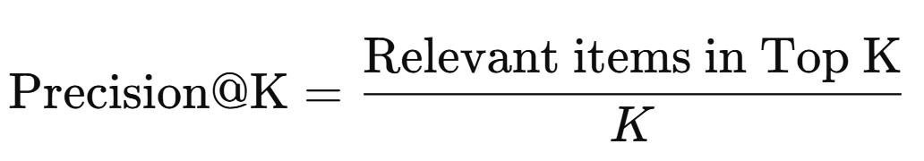
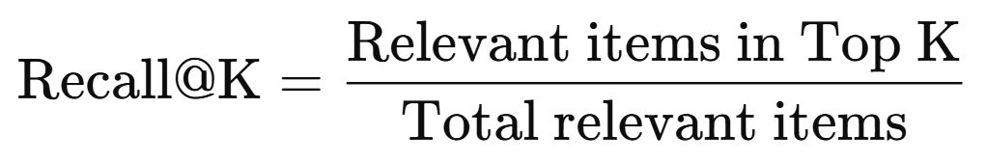
2. Dataset
For each user, algorithm reccomend top-K most relevant, and result will be calculated as:
Precision@K:
Recall@K:

Slide 8
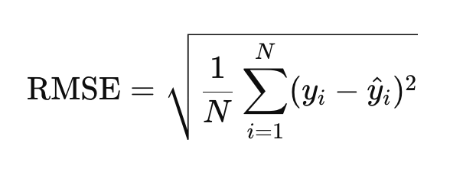
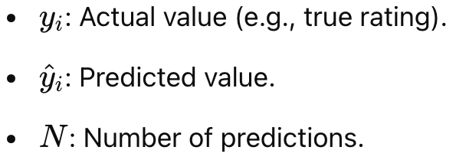
2. Dataset
- RMSE:

Slide 9
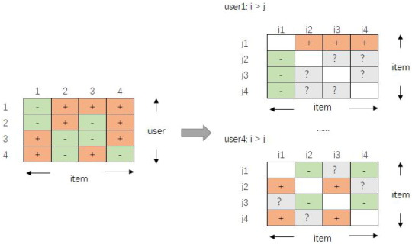
3. Methods
BPR is designed for personalized ranking preferred items higher than non-preferred ones for a given user.
Key Concepts:
1. Implicit Feedback:
• Observed data (positive interactions, e.g., purchases, clicks) vs. unobserved data (a mix of true negatives and unknowns).
2. Pairwise Ranking:
• Replaces pointwise loss with pairwise loss.
• Optimizes ranking by maximizing the margin between preferred i and non-preferred items j.

Slide 10
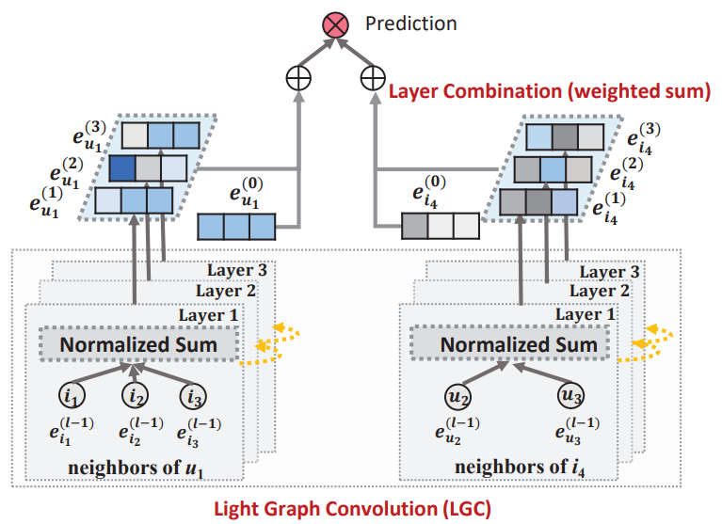
3. Methods
LightGCN[1] consists of two main components:
Simple Graph Convolution (LGC): Aggregates neighbor embeddings without self-connections, feature transformations, or non-linear activations for efficiency.
Layer Combination: Combines embeddings from all layers to form final user and item representations, addressing over-smoothing.
[1] He et al. LightGCN: Simplifying and Powering Graph Convolution Network for Recommendation (SIGIR 2020)

Slide 11
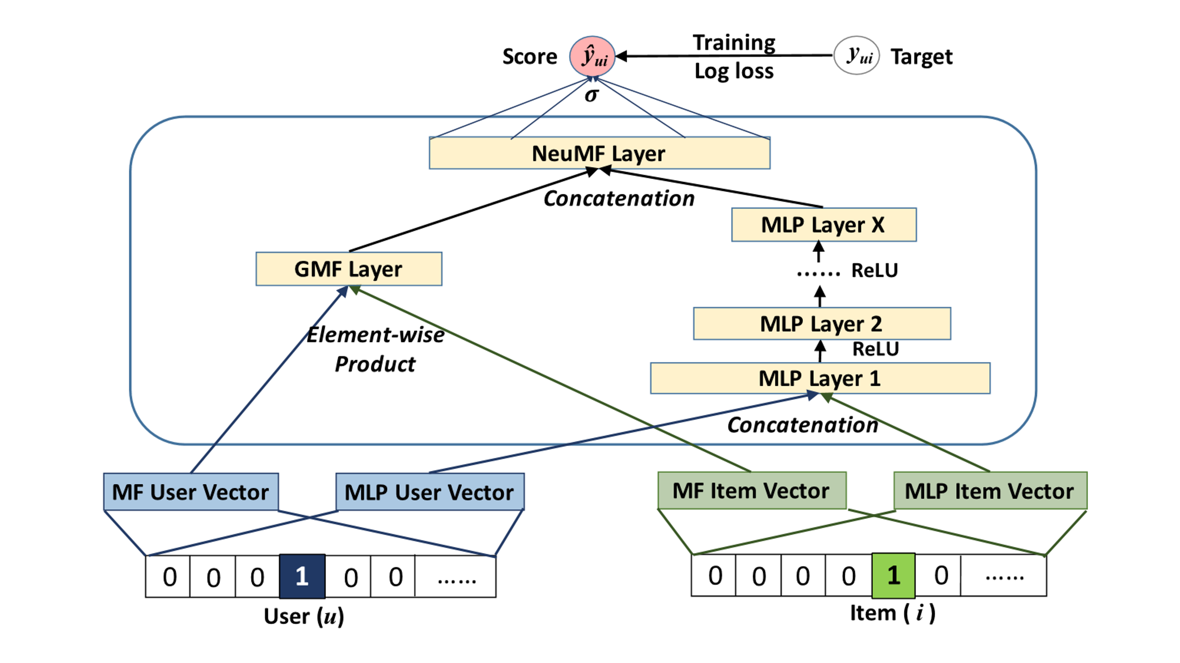
3. Methods
NCF is a neural matrix factorization model ensembles two components:
Generalized Matrix Factorization(GMF): MF can be easily generalized and extended as GMF introduces a neural Collaborative Filtering layer as the output layer of standard MF.
Multi-Layer Perceptron(MLP): Learning interactions after concatenating of users and items latent features

Slide 12
Experimental Results
Experimentation:
Model | RMSE | Precision@10 | Recall@10
LightGCN | N/A | 0.3514 | 0.2330
BPR | N/A | 0.3550 | 0.1802
BiVAE | N/A | 0.3484 | 0.1914
NCF | N/A | 0.1830 | 0.1027
MF(baseline) | 0.9488 | 0.1004 | 0.0353

Slide 13
4. Cold Start Problem
In typical, predictions are based on user-item interaction history. A warm-start scenario assumes sufficient data is available to learn user preferences and item popularity, allowing algorithms to effectively suggest relevant content.
In cold-start scenarios, new users or items lack interaction history.
- This can drastically reduce the effectiveness of CF methods
Model | Cold |  | Warm-A |  | Warm-B |  | Warm-C
 | P@10 | R@10 | P@10 | R@10 | P@10 | R@10 | P@10 | R@10
LightGCN | 0.000 | 0.000 | 0.0027 | 0.0019 | 0.0049 | 0.0038 | 0.0228 | 0.0282

Slide 14
4. Cold Start Problem
For Cold Start Problem Setting:
We define hot items are movies that have interactions > N, represent train data.
Cold items are remain movies, have interactions > 3.K.
We will develop 4 phase and 4 data on cold start scenario:
The first K interactions of a cold item will be assigned to Phase A, the next K interactions to Phase B, the following K interactions to Phase C, and the remaining interactions will be used as the test data.
We will evaluate on 4 phases, first is cold with only train data, next is Warm Phase A with warm_a data, etc...

Slide 15
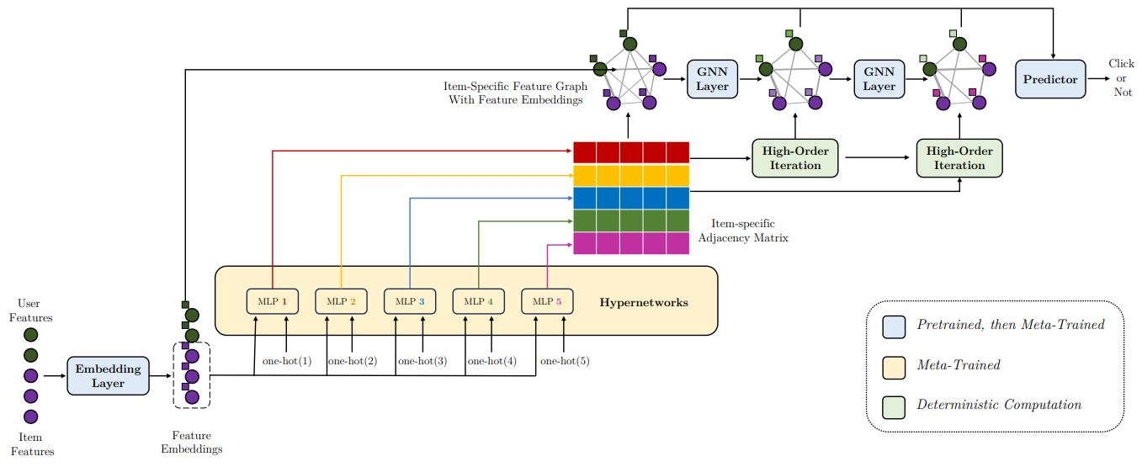
4. Cold Start Problem
EmerG [2] enhances prediction by combining hypernetworks and GNN:
Item-specific interactions: EmerG constructs unique feature graphs for each item, capturing complex item-user relationships for better predictions.
Hypernetwork-generated adjacency matrices: This enables diverse feature interaction modeling instead of a one-size-fits-all approach.
Customized GNN message passing: Tailored mechanisms in GNNs capture higher-order feature interactions for improved accuracy.
[2] Wang et al. Item-Specific Feature Interactions for Cold-Start CTR Prediction (KDD 2024)

Slide 16
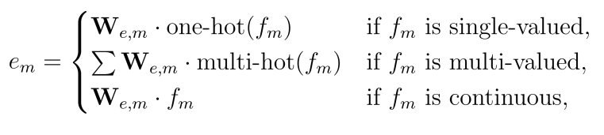
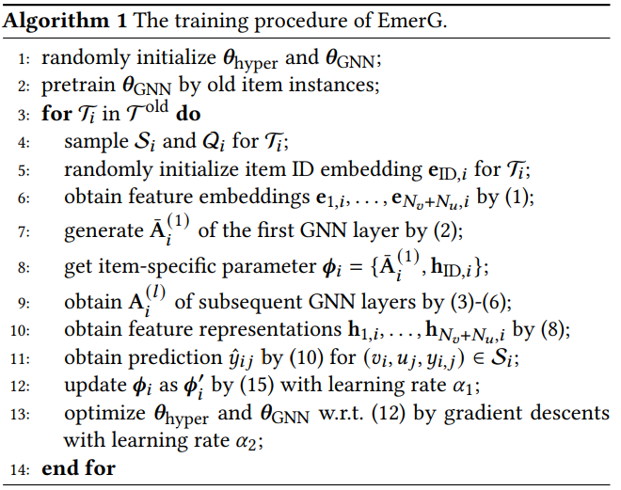
4. Cold Start Problem
GNN is used to process and predict the likelihood of user-item interactions:
Meta learning optimizes parameters of hypernetworks and GNN across various item CTR prediction tasks, while only adjusting a small set of item-specific parameters within each task:

Slide 17
4. Cold Start Problem
Modification:
EmerG is designed to predict Click-through Rate (CTR). Which estimate the probability that a user click on or choose an item, such as movie, to watch.
The label result only 1 (click) or 0 (not click), so we need to modify to the predict top-k movie problem as we proposed.
We will train item that labels 5 (highest) as 1, and remain as 0, take top-K highest click rate movie to predict and evaluate Precision@K and Recall@K

Slide 18
5. Experimental Results
Cold Start Experiment:
Model | Cold |  | Warm-A |  | Warm-B |  | Warm-C
 | P@10 | R@10 | P@10 | R@10 | P@10 | R@10 | P@10 | R@10
LightGCN | 0.000 | 0.000 | 0.0027 | 0.0019 | 0.0049 | 0.0038 | 0.0228 | 0.0282
EmerG | 0.2325 | 0.1749 | 0.2509 | 0.1522 | 0.2604 | 0.1546 | 0.2654 | 0.1561

Slide 19
6. Conclusion
In this project, we evaluated several recommendation models using the MovieLens 100K dataset, including LightGCN, BiVAE, BPR, LightFM, NCF, and MF on metrics Precision@10, Recall@10. LightGCN and BPR performed particularly well, providing relevant and comprehensive recommendations across various scenarios.
To address the cold-start challenge, we explored EmerG, which emerged as a robust solution. Our experiments showed that EmerG effectively handled new users and items, improving recommendation quality for cold-start, and warm start scenarios.

Slide 20
Contribution
Member | Method
Nguyễn Thanh Bình | MF, BPR
Lê Ngọc Bình | NCF
Trần Quốc Đệ | DeepFM, FM
Nguyễn Nam Hải | BiVAE
Phan Đức Hưng | LightGCN, EmerG

